Slide 1
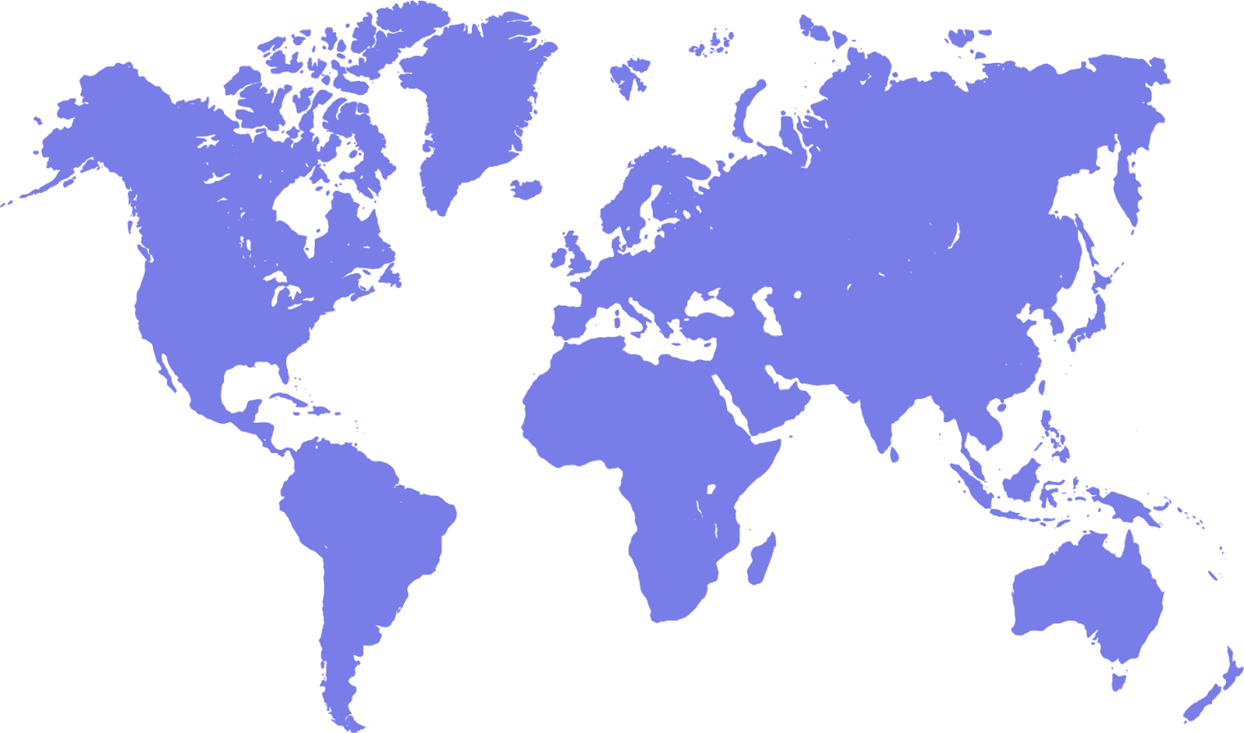
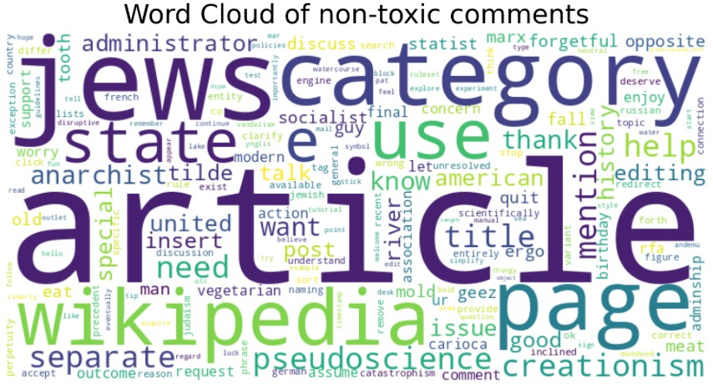

NLP Project
Toxic comments classification
Idan Morry Vazana
Roni Shternberg
JUNE 2023
Link to notebook

Slide 2
Overview
Research Question and Dataset
Challenge and Motivation
EDA (Exploratory Data Analysis)
Automatic and fast EDA - SweetViz
Plotly
Word Cloud
Preprocessing – SpaCy
Word Embedding: TF-IDF Vectorizer
Classification models:
Scikit-Learn models:
Logistic Regression
LinearSVC
MultinomialNB (Naïve Bayes)
BERT model (Huggingface pre-trained):
BertTokenizer, BertForSequenceClassification - 'bert-base-uncased’
Fine-Tuning/Transfer Learning with PyTorch framework
Results and metrics comparison
Conclusions and further steps
Notes:
להוסיף נקודות

Slide 3
Research Question and Dataset
The research question and objective of this project is, whether we can classify toxic comments that appear in Wikipedia Talk Pages (aka. “discussion pages”) with a reasonably high accuracy.
The Dataset is taken from Kaggle competition held 5 years ago.
It contains approximately 160K rows, with 8 columns: ‘id’, ‘comment_text’ and 6 types of toxicity target labels (1/0), which have been labeled by human raters of toxic behavior:
There are no missing values and no duplicates
We decided to sample the dataset (10%) due to computational resources considerations.
Toxic – Very bad, unpleasant, harmful.
Severe toxic – Extremely bad and offensive.
Obscene – Description of sexual matters.
Threat – a statement of an intention to inflict pain, injury, or damage.
Insult – speak to or treat with disrespect or scornful abuse.
Identity hate – hatred, hostility, or violence towards ethnicity, nation, religion, gender.

Slide 4
Challenge and Motivation
Type of NLP Challenge: Text classification - A task of categorizing text documents into predefined classes or categories. It is a fundamental problem in NLP with various applications, such as:
1. Sentiment Analysis: Determine the sentiment expressed in a text as positive, negative, or neutral.
2. Spam Detection (in emails)
3. Topic Categorization: Classify news into categories such as sports, politics, entertainment, or technology.
4. Intent Recognition: Identify the intent or purpose behind a user's query or statement.
(e.g., classify customer queries in a Chatbot as inquiries, complaints, or requests for assistance).
5. Named Entity Recognition (NER) (e.g., Identify and classify person names, locations, organizations).
6. Language Identification (e.g., English, Spanish, or French).
Motivation:
A lot of websites run on user generated content and are dependent on user discussions to curate and approve content.
People frequently write toxic, inappropriate or offensive things they shouldn’t, and to maintain a positive community this content and the users posting it need to be removed quickly.
Hiring full-time moderators to review every comment is expensive.

Slide 5
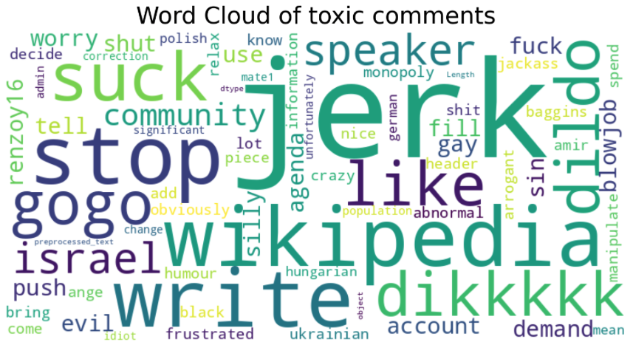
Word Cloud
Notes:
להוסיף נקודות

Slide 6
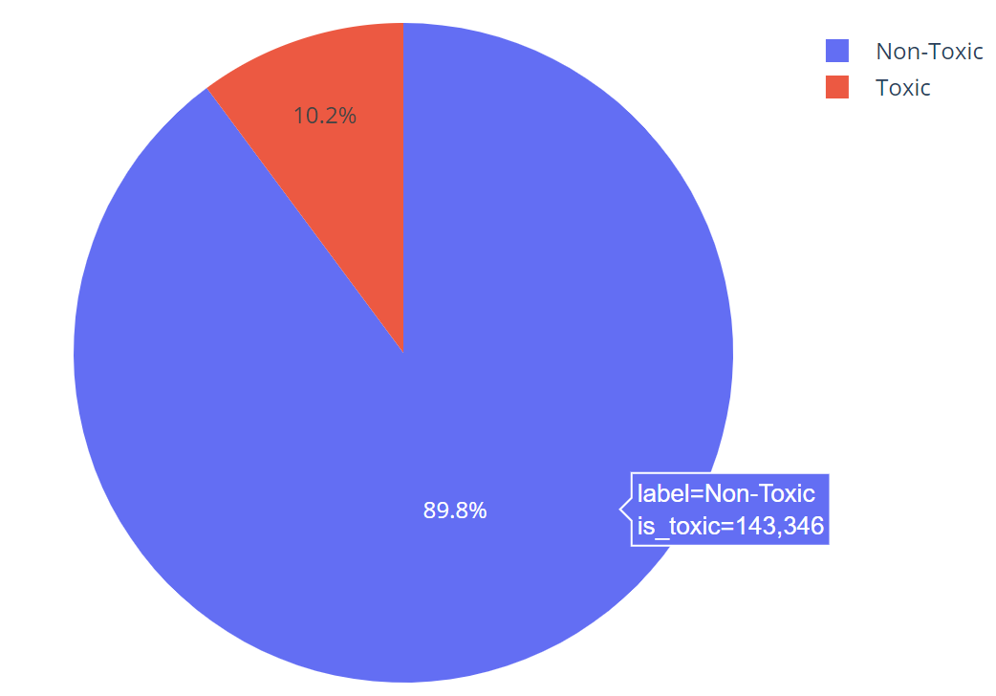
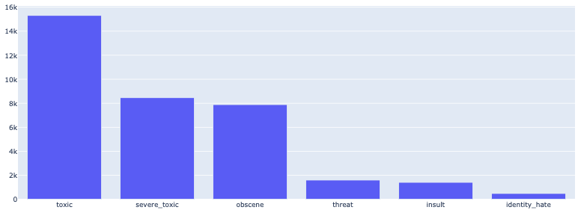
EDA
Toxic Vs. Non-Toxic
Toxic comment target labels Distribution
Dataset is imbalanced: ~10%/90% Toxic/Non-Toxic.
Thus, we will use the F1-score since it is a harmonic average between precision and recall. This combines the strengths of precision and recall while balancing out their weaknesses, creating a score that can fairly evaluate models regardless of dataset imbalance.

Slide 7
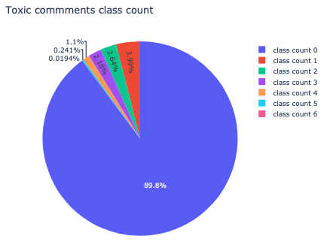
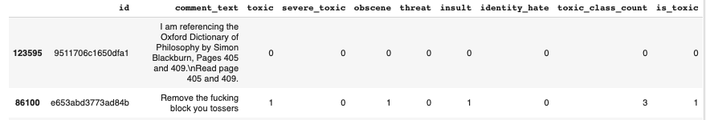
EDA

Slide 8
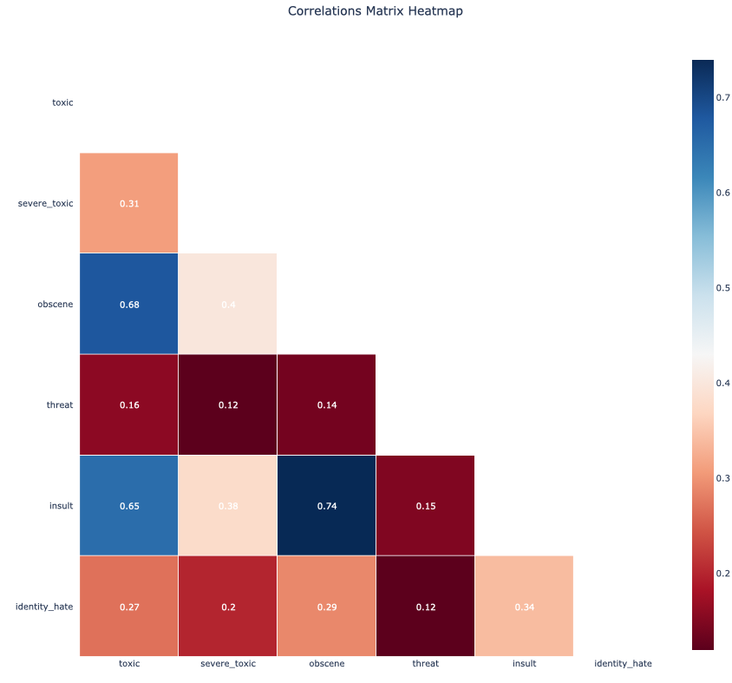
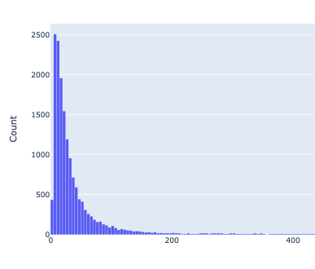
EDA
Correlation matrix heatmap
Number of tokens in a comment histogram
Number of tokens

Slide 9
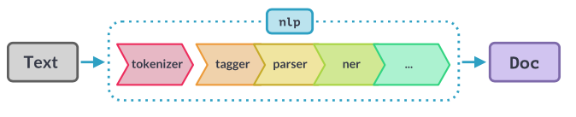
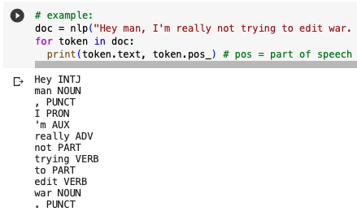
SpaCy pipeline
Notes:
INTJ – A Word or phrase used to express strong emotion or surprise.
Noun: A word that represents a person, place, thing, or idea.
Pronoun (PRON): A word used in place of a noun to refer to a person or thing.
Adverb (ADV): A word that modifies a verb, adjective, or other adverb.
Verb: A word that expresses an action, occurrence, or state of being.
Punctuation (PUNCT): Is used to identify punctuation marks in a sentence.
Auxiliary Verb (AUX): The "AUX" tag is used to represent auxiliary verbs. Auxiliary verbs are verbs that accompany the main verb in a sentence and help to express grammatical aspects such as tense, mood, voice, or aspect. Ex

Slide 10
Preprocessing using SpaCy
Tokenization (as seen in previous slide)
Remove punctuation
Remove stop words
Remove numbers and currency
Remove URL’s
Convert to lower case.
Lemmatization (“Walking -> “walk”) – Except for BERT model

Slide 11
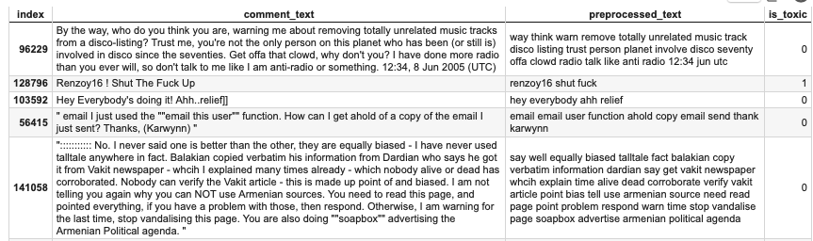
Preprocessing: Before and after

Slide 12
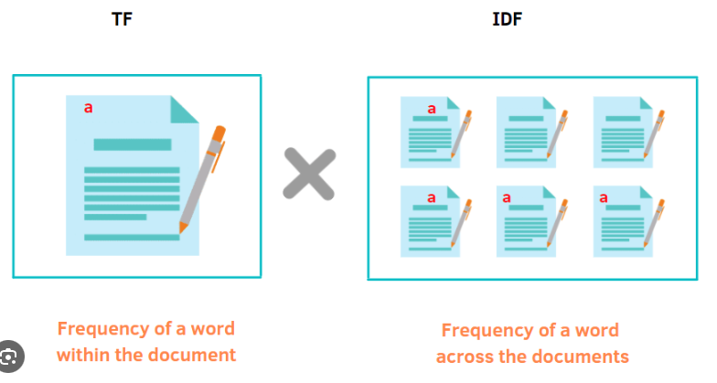
TF-IDF Vectorizer
Sklearn’s TfidfVectorizer class is used for Word Embedding (transform the words into vectors).
We use it in all the Sklearn models we work with later.
Term Frequency (TF): It calculates the frequency of each term (word) within a document. The assumption is that the more frequently a term appears in a document, the more important it is to that document.
Inverse Document Frequency (IDF): It measures the rarity or uniqueness of a term across the entire document corpus. The assumption
is that terms that occur in fewer documents are more
Informative or significant.

Slide 13



PyTorch – with BERT

Slide 14
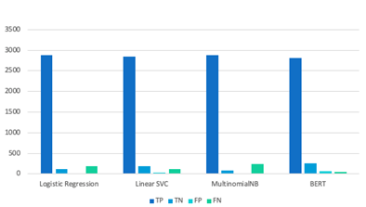
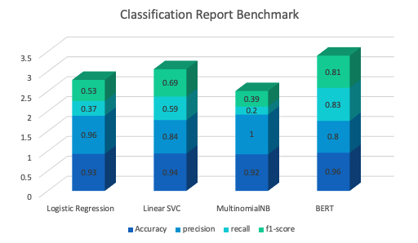
MODELS, SCORING & RESULTS
Confusion Matrix Benchmark
Logistic regression
Linear SVC
Multinomial Naive Bayes
BERT
Accuracy
Precision
Recall
F1 score
Notes:
The logistic regression model achieves a high accuracy of 0.93, indicating that it correctly classifies 93% of the time in your toxic/non-toxic classification task. It also has a high precision of 0.96, which implies that when it predicts a comment as toxic, it is correct 96% of the time. However, the recall and F1 scores are relatively low, 0.37 and 0.53, respectively, indicating that the model has difficulty identifying all toxic comments correctly.
The linear SVC model performs slightly better than logistic regression with an accuracy of 0.94. It shows a good balance between a precision of 0.84 and a recall of 0.59, resulting in an F1 score of 0.69. This suggests that the model maintains a reasonable trade-off between correctly identifying toxic annotations and minimizing false positives.
MultinomialNB achieves an accuracy of 0.92, indicating an overall high classification performance for your toxic/non-toxic classification task. It exhibits perfect accuracy 1.0, meaning it does not produce false positive predictions. However, the recall is relatively low at 0.2, indicating that the model has difficulty identifying a significant proportion of the toxic comments. As a result, the F1 score is 0.39, reflecting the unbalanced performance between precision and recall.
BERT outperforms the other models with a high accuracy of 0.96 in our project. It exhibits good precision of 0.8 and recall of 0.83 values, resulting in an F1 score of 0.81. This indicates that BERT achieves a strong balance between precision and recall, making it well-suited for the accurate classification of toxic and non-toxic annotations.
In summary, BERT stands out as the best performer, with high precision, a solid balance between precision and recall, and an excellent F1 score. Furthermore, it is necessary to consider other factors such as computational resources, data size, and time which the BERT model also required a lot of adjustment.
On the Confusion matrix logistic regression and MultinomialNB show high true positive rates but struggle with false negatives, while linear SVC achieves a reasonable balance.
BERT turns out to be a strong performer with a good balance of true positives, true negatives, false positives, and false negatives.
Based on these observations, we can conclude that BERT is the most promising model for the accurate classification of toxic and non-toxic comments.

Slide 15
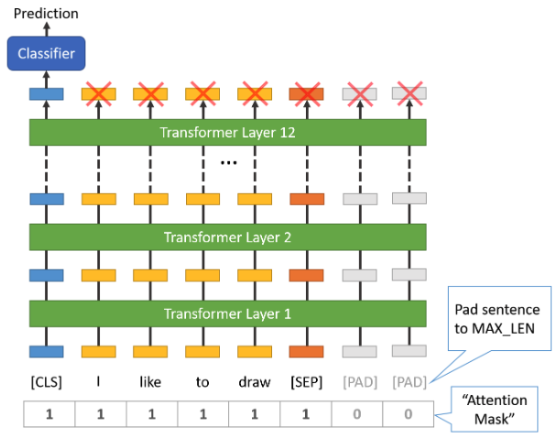
BERT - Bidirectional Encoder Representations from Transformers
Self-Attention Mechanism with 12 (or 24) transformer layers.
Released in late 2018 - a breakthrough year in NLP.
BERT pretrained models can be fine-tuned easily with less data and less compute time to produce state of the art results in text classification.
Contextualized Representations:
These representations incorporate information
from both preceding and following tokens
Feature Extraction:
Each transformer layer in BERT extracts higher-
level features from the input tokens
Notes:
How does it work?
Self-Attention Mechanism: The self-attention mechanism allows each word/token in the input sequence to attend to other words/tokens in the same sequence. It helps capture dependencies and relationships between different words, enabling BERT to understand the contextual information effectively.
Encoding Contextualized Representations: Each transformer layer takes in the input tokens and generates contextualized representations for each token. These representations incorporate information from both preceding and following tokens, allowing BERT to capture the context in which each word appears.
Feature Extraction: Each transformer layer in BERT extracts higher-level features from the input tokens. The lower layers focus on low-level features, such as word forms and syntax, while the higher layers capture more abstract and semantic information.
Fine-tuning and Transfer Learning: The multiple layers in BERT provide a hierarchical representation of the input text. After pretraining on large-scale corpora, the pre-trained BERT model can be fine-tuned on specific downstream tasks, such as sentiment analysis or named entity recognition. The layers closer to the input can capture task-independent features, while the deeper layers can adapt to task-specific patterns during fine-tuning.
Each transformer layer involves multiple sub-layers, such as self-attention and feed-forward neural networks, which contribute to the overall transformation of the input tokens at each layer.

Slide 16
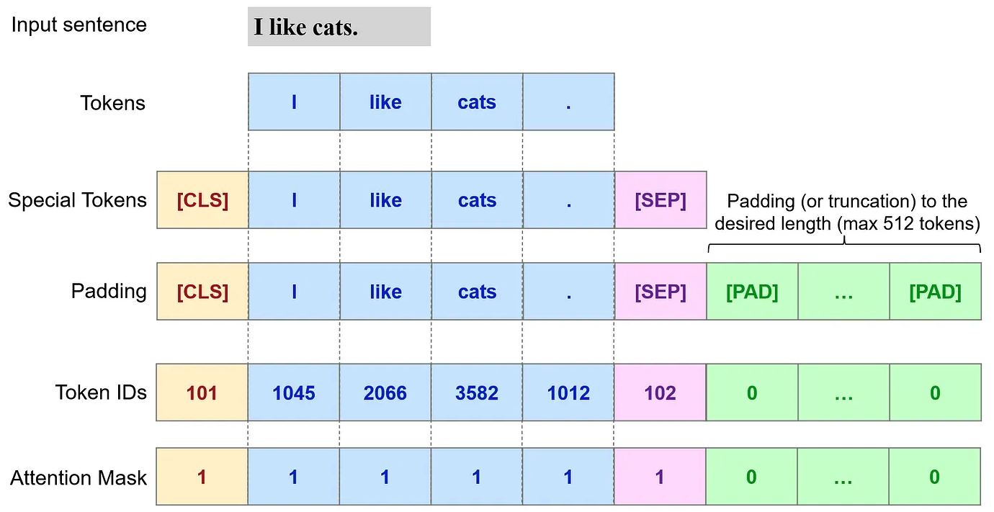
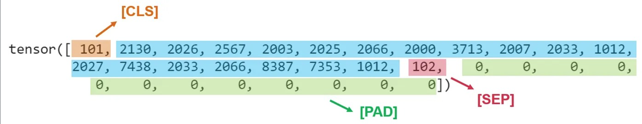
BERT - Tokenization
Notes:
How does it work?
Self-Attention Mechanism: The self-attention mechanism allows each word/token in the input sequence to attend to other words/tokens in the same sequence. It helps capture dependencies and relationships between different words, enabling BERT to understand the contextual information effectively.
Encoding Contextualized Representations: Each transformer layer takes in the input tokens and generates contextualized representations for each token. These representations incorporate information from both preceding and following tokens, allowing BERT to capture the context in which each word appears.
Feature Extraction: Each transformer layer in BERT extracts higher-level features from the input tokens. The lower layers focus on low-level linguistic features, such as word forms and syntax, while the higher layers capture more abstract and semantic information.
Fine-tuning and Transfer Learning: The multiple layers in BERT provide a hierarchical representation of the input text. After pretraining on large-scale corpora, the pre-trained BERT model can be fine-tuned on specific downstream tasks, such as sentiment analysis or named entity recognition. The layers closer to the input can capture task-independent features, while the deeper layers can adapt to task-specific patterns during fine-tuning.
Each transformer layer involves multiple sub-layers, such as self-attention and feed-forward neural networks, which contribute to the overall transformation of the input tokens at each layer.

Slide 17
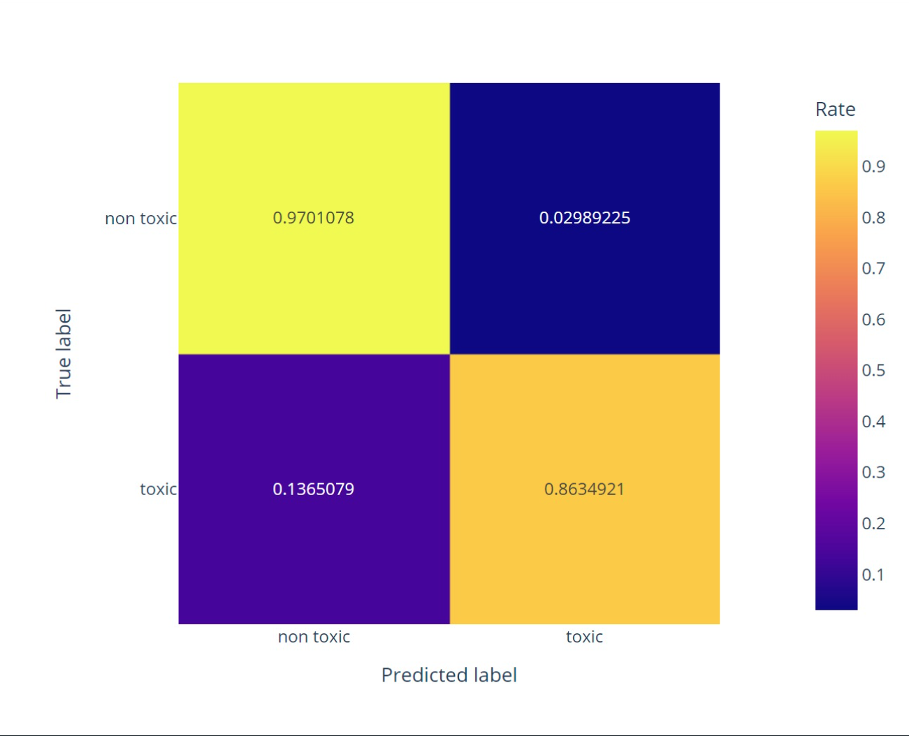
BERT – Confusion Matrix
Notes:
How does it work?
Self-Attention Mechanism: The self-attention mechanism allows each word/token in the input sequence to attend to other words/tokens in the same sequence. It helps capture dependencies and relationships between different words, enabling BERT to understand the contextual information effectively.
Encoding Contextualized Representations: Each transformer layer takes in the input tokens and generates contextualized representations for each token. These representations incorporate information from both preceding and following tokens, allowing BERT to capture the context in which each word appears.
Feature Extraction: Each transformer layer in BERT extracts higher-level features from the input tokens. The lower layers focus on low-level linguistic features, such as word forms and syntax, while the higher layers capture more abstract and semantic information.
Fine-tuning and Transfer Learning: The multiple layers in BERT provide a hierarchical representation of the input text. After pretraining on large-scale corpora, the pre-trained BERT model can be fine-tuned on specific downstream tasks, such as sentiment analysis or named entity recognition. The layers closer to the input can capture task-independent features, while the deeper layers can adapt to task-specific patterns during fine-tuning.
Each transformer layer involves multiple sub-layers, such as self-attention and feed-forward neural networks, which contribute to the overall transformation of the input tokens at each layer.

Slide 18
Further Research
Multiclass classification into 6 toxic target labels as opposed to just toxic/non-toxic.
Imbalanced data: use RandomUnderSampler (from imblearn) to Under-sample the majority class
Spelling correction: use spell function (from autocorrect library).
Use large SpaCy ("en_core_web_lg" instead of "en_core_web_sm”).
An attempt to filter the word Wikipedia from the comments (in the word cloud you can see that it is very significant).
Hyper-Parameter Tuning (e.g., Grid Search):
Learning Rate (2e-5), MAX_LEN (512), BATCH_SIZE (16), NUM_EPOCHS (2-5)
K-Fold Cross-Validation.
BERT Cased (We used Uncased)
In BERT – don’t use lemmatization (in preprocessing step)
SpaCy Text Categorizer.

Slide 19

Thank you!
Notes:
להוסיף נקודות

